Slide 1
Paraphrase Identification

Slide 2
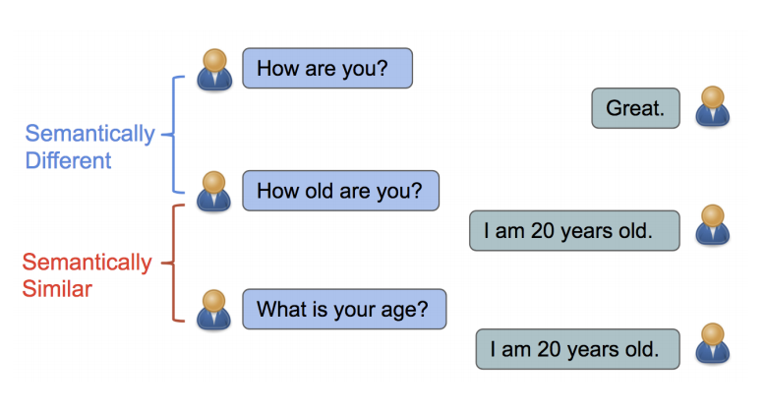
Paraphrase Identification Task
The task is to determine whether two given text segments express the same meaning.
Focuses on semantic equivalence, despite differences in wording or structure.
Besides plagiarism detection, this task can also be useful in numerous real-world applications such as:
Information retrieval
Machine translation
Sentiment analysis
Question answering.

Slide 3
Challenges
Identifying paraphrasing has become pivotal and challenging in natural language processing and understanding.
Challenges due to linguistic variability, semantic complexity, cultural nuances, subtleties in language, syntax-semantics distinction, data sparsity, extensive dataset needs, cross-language issues, subjective evaluations, and domain-specific jargon.
Traditional based approaches and ML based approaches may struggle with capturing higher level semantic relationships.

Slide 4
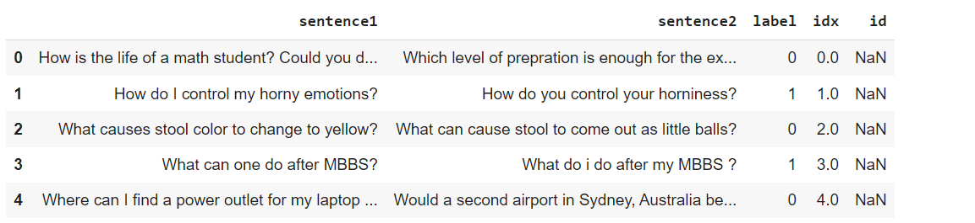
Data Collection
The dataset is the combination of three datasets namely MRPC (microsoft research paraphrase corpus), QQP (quora question pairs) and PAWS (paraphrase adversaries from word scrambling).
Qqp: this dataset consists of 363846 question pairs from quora for paraphrase identification.
Paws: this dataset contains pairs that are generated from both word swapping and back translation methods. This focuses on cross-lingual paraphrase identification. Here we’ve used only EN version of it. It consists of 49401 sentence pairs.
Mrpc: this is a binary classification dataset consists of 5800 sentence pairs extracted from news articles, labelled as either paraphrased or not paraphrased.
Notes:
We've used a custom dataset that consists of 3 datasets. They're: MRPC, QQP and PAWS
QQP - 363846
MRPC - 3668
PAWS - 49401

Slide 5
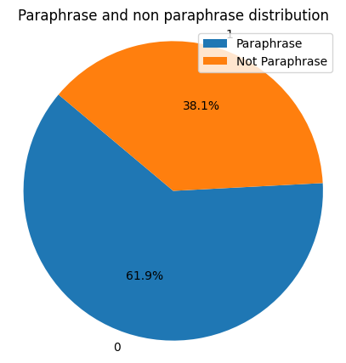
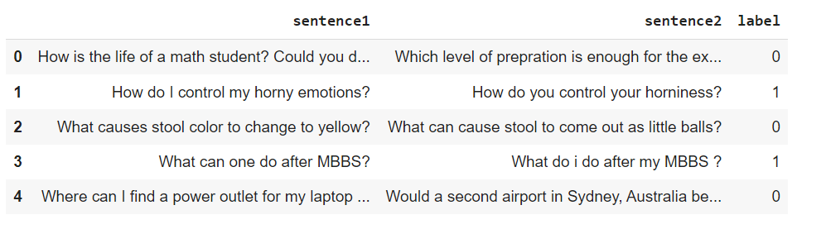
Dataset Overview
The dataset contains around 416915 records and each record contains labels, sentence1 and sentence2.
The combined dataset consists of entities like sentence1, sentence2 and label where all the paraphrase labels are marked as 1 and not paraphrase as 0.
We considered only a fraction of original dataset (10%) to train the models on.
Dataset size = 41692
Training size = 37522
validation size = 4170
Notes:
The combined dataset comprises of around 410k samples and each record comprises of label, sentence1 and sentence2.
The labels are categorized as 1 for paraphrase and 0 for not paraphrase as you can see in the figure.
While combining the dataset we’ve performed some preprocessing like renaming the columns and label encoding in order to maintain consistency.
We’ve taken a fraction of sample for the training purpose because of the limited computational resources for training the models.
Here’s the distrubution of paraphrase and not paraphrase sentence pairs

Slide 6
Data Preprocessing
Raw Data
Duplicate detection and handling
Removal of null values
Special Character removal
Tokenization
Cleaned Data

Slide 7
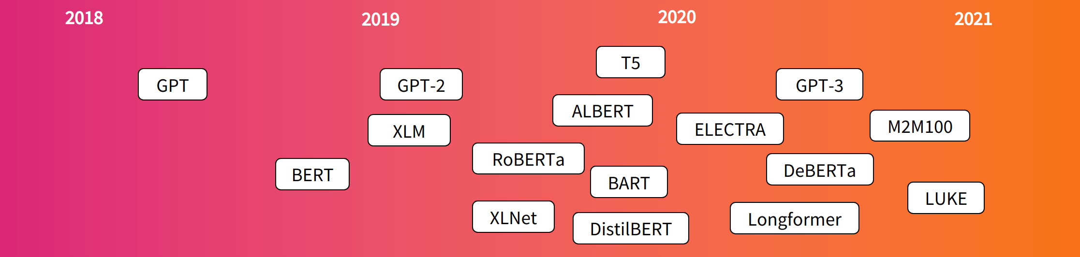
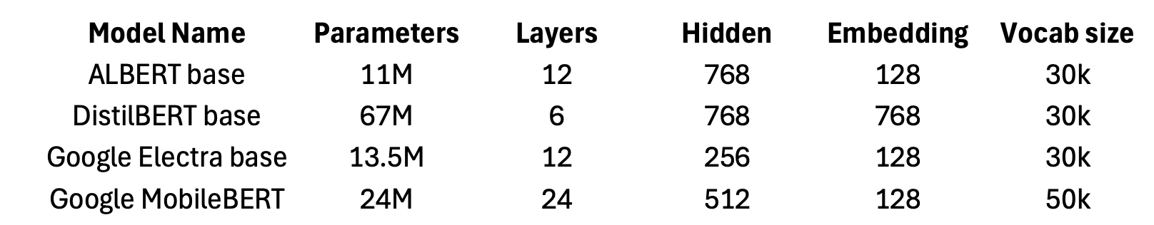
BERT Models
Here are our models for comparision:
ALBERT (A lite BERT)
Distilbert (A distilled version of BERT)
Google ELECTRA (efficiently learning an encoder that classifies token replacements accurately)
Mobilebert (for mobile devices)
Notes:
Here are the variants of small BERT models that we’ve considered for fine-tuning:
ALBERT - short for A lite BERT - Addresses the challenges for memory limitations for training. It uses absolute position embeddings and repeating layers, resulting in a small memory footprint
DistilBERT - Distilled version of BERT model with reduced 40% size and retains 97% of BERT base performance.
ELECTRA - It is developed by Google and uses replaced token detection as a pre-training approach instead of masked language modelling used in BERT
MobileBERT - It’s a bidirectional transformer used for running on mobile devices. It has a bottleneck architecture for reduced memory usage. It is compressed and accelerated.
Here are the configurations for the models used for the task.

Slide 8
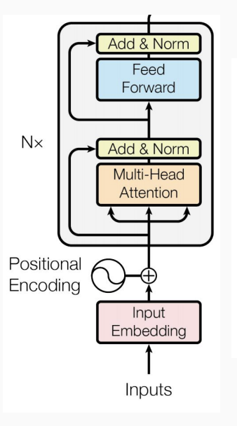
Why Transformers?
Transformer based models are great for paraphrase identification due to the contextual understanding, attention mechanism, bidirectional encoding and transfer learning capabilities.
Bert(bidirectional encoder representations from transformers) based models can capture contextual information effectively.
Perform comprehensive comparison by finetuning various bert based models for different paraphrase identification scenarios.
Notes:
Transformers excel in paraphrase identification due to their ability to capture contextual relationships, employ attention mechanisms, and leverage bidirectional encoding, enabling them to accurately capture semantic differences.
We’re using BERT based transformers for this task because of their great performance for down streaming tasks and can capture the contextual info effectively.
The main motive of this project is to evaluate different BERT based models for effectively identifying paraphrases. We’ve fine-tuned several small BERT based models on the custom dataset specific to this task

Slide 9
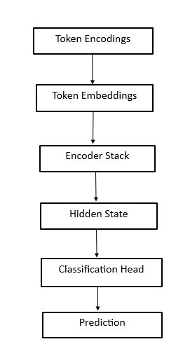
Pipeline Design
Import models and tokenizers:
Distilbert + distilbert tokenizer
Mobilebert + mobilebert tokenizer
ALBERT + ALBERT tokenizer
ELECTRA + ELECTRA tokenizer
Squeezebert + squeezebert tokenizer
Each model is equipped with its own tokenizer to ensure optimal compatibility
& performance.
Append a classification layer to each model to predict paraphrase labels (0 or 1).
Configure training parameters: setup batch sizes, learning rates, and number of epochs.
Notes:
Here's the overview of the pipeline design that we've impemented for fine tuning the models:
The input text is converted into embeddings to be processed by BERT and the tokens are preprocessed according to model format and passed to encoder stack.
the embeddings are passed through mutliple t/f blocks and outputs the trasformed input at the last hidden state.
The hidden state contains the contextualized representations of i/p tokens and are passed to classification head to predict the paraphrase labels.
Classification head typically consists of pooling layer, additional fully connected layers and softmax layer to determine the probablity distributions of two classes.

Slide 10
Finetuning Models
For training the models on the dataset, the following configuration is used:
Batch size = 32
Fine tuning for 3 epochs
Learning rate = 0.00002
Weight decay = 0.01
Adamw (pytorch) optimisation strategy
Contrast the performance metrics (loss, accuracy, F1 score) across all models.
Notes:
Import Models and Corresponding Tokenizers from Hugging Face's Transformers library
Load the pretrained models and configure the training parameters such as epochs, batch size
Here's the configuration that we've used to train all the BERT models
- We're doing the training in batches with batch size of 32.
- Each model is trained for 3 epochs
- LR and Weight decay parameter is set to those specified values
- We've used AdamW optimization strategy which is a variant od Adam optimizer
We've finetuned all the models in the Google Colab environment with GPU
Finally, we've compared all the metrics such as accuracy, F1 score, losses for all the models
(wieght decay is to prevent the model from overfitting and it is an L2 regularization technique)
(Optimizer is used for updating the model's parameters, hyper parameters based on calculated gradients. It also provides regularization, convegence)

Slide 11
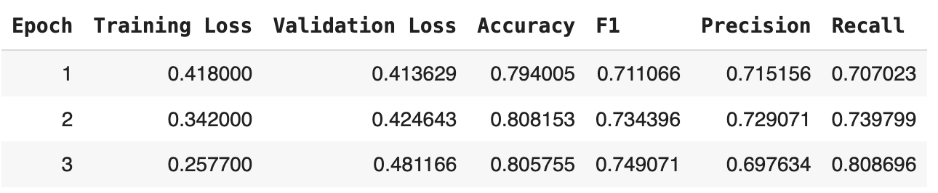
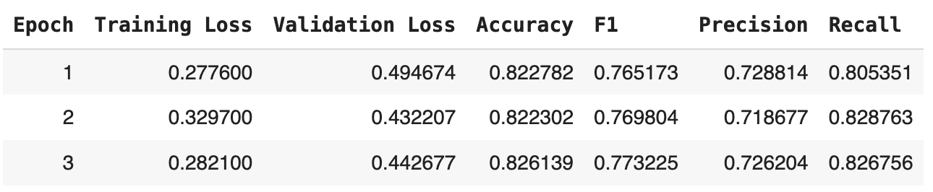
Results
DistilBERT
ELECRTA
Notes:
Here's the overview of the metrics from the training of all models:
- DistilBERT has an accuracy of 80%
- Electra has accuracy of 82 %
- MobileBERT

Slide 12
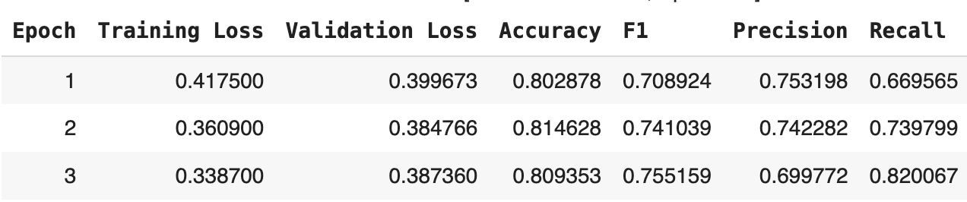
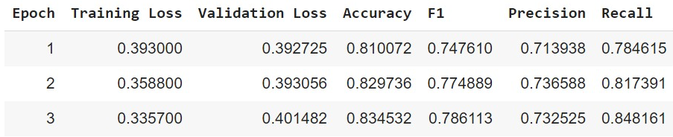
Results
MobileBERT
ALBERT

Slide 13
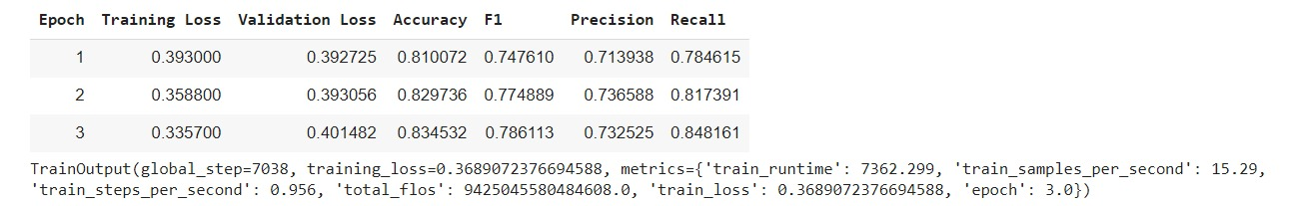
Results:
Squeeze BERT

Slide 14
Observations
Inference on the ALBERT model:
Inference in the distilbert model:
Albert has the best accuracy and f1 score performance and computationally heavy when compared to other models
The fastest model google ELECRTA, compared to ALBERT with more than x10 speed.
Large language models can also be used to detect paraphrases, but the cost and complexity of their finetuning are significantly larger compared with regular bert-based models
Notes:
Here are the sample predictions from the Albert and Distilbert model
Of all the models considered for the task, Albert model has the highest accuracy and best F1 score. Albert is computionally heavy and it took around 3 hours for training with the mentioned configurations.
The fastest model to train is Electra as it took around 30 mins.
MobileBERT and DistilBERT have similar accuracies.
If time permits, we might perform a small experiment with LLMs

Slide 15
References
“Comparative analysis of transformer based pre-trained NLP models”. By singla, saurav. (2020) international journal of computer sciences and engineering. 8. 40-44. 10.26438/ijcse/v8i11.4044.
“Paraphrase identification with deep learning: a review of datasets and methods” by chao zhou (department of computer science, syracuse university), cheng qiu (school of arts and science, vanderbilt university), daniel e. Acuna (department of computer science, university of colorado at boulder)
BERT 101 https://huggingface.Co/blog/bert-101
Code for the dataset preparation : paraphrase_dataset

Slide 16
Thank You

